Slide 1
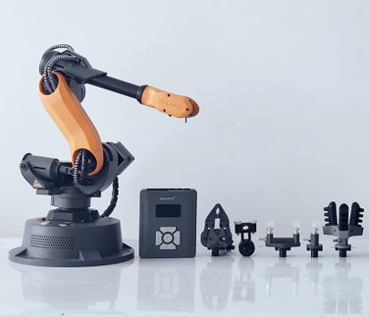

Medical Robotics Group Coursework
Group 14:
Gavin Z Yue (02469416)
Xinru Yan (02450945)
Zakariya Ali (02354549)

Slide 2
Task 1
Robot Modelling and MDH Table

Slide 3
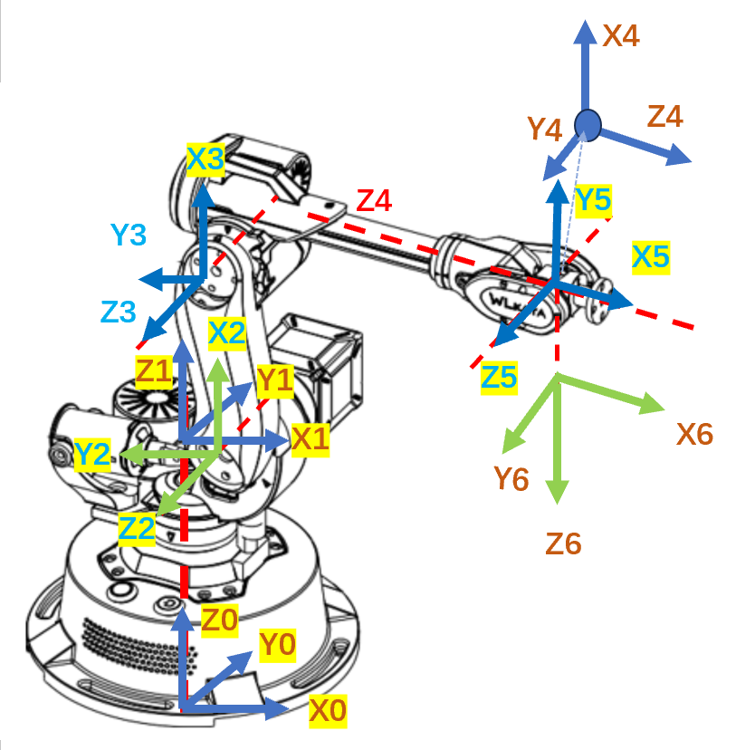
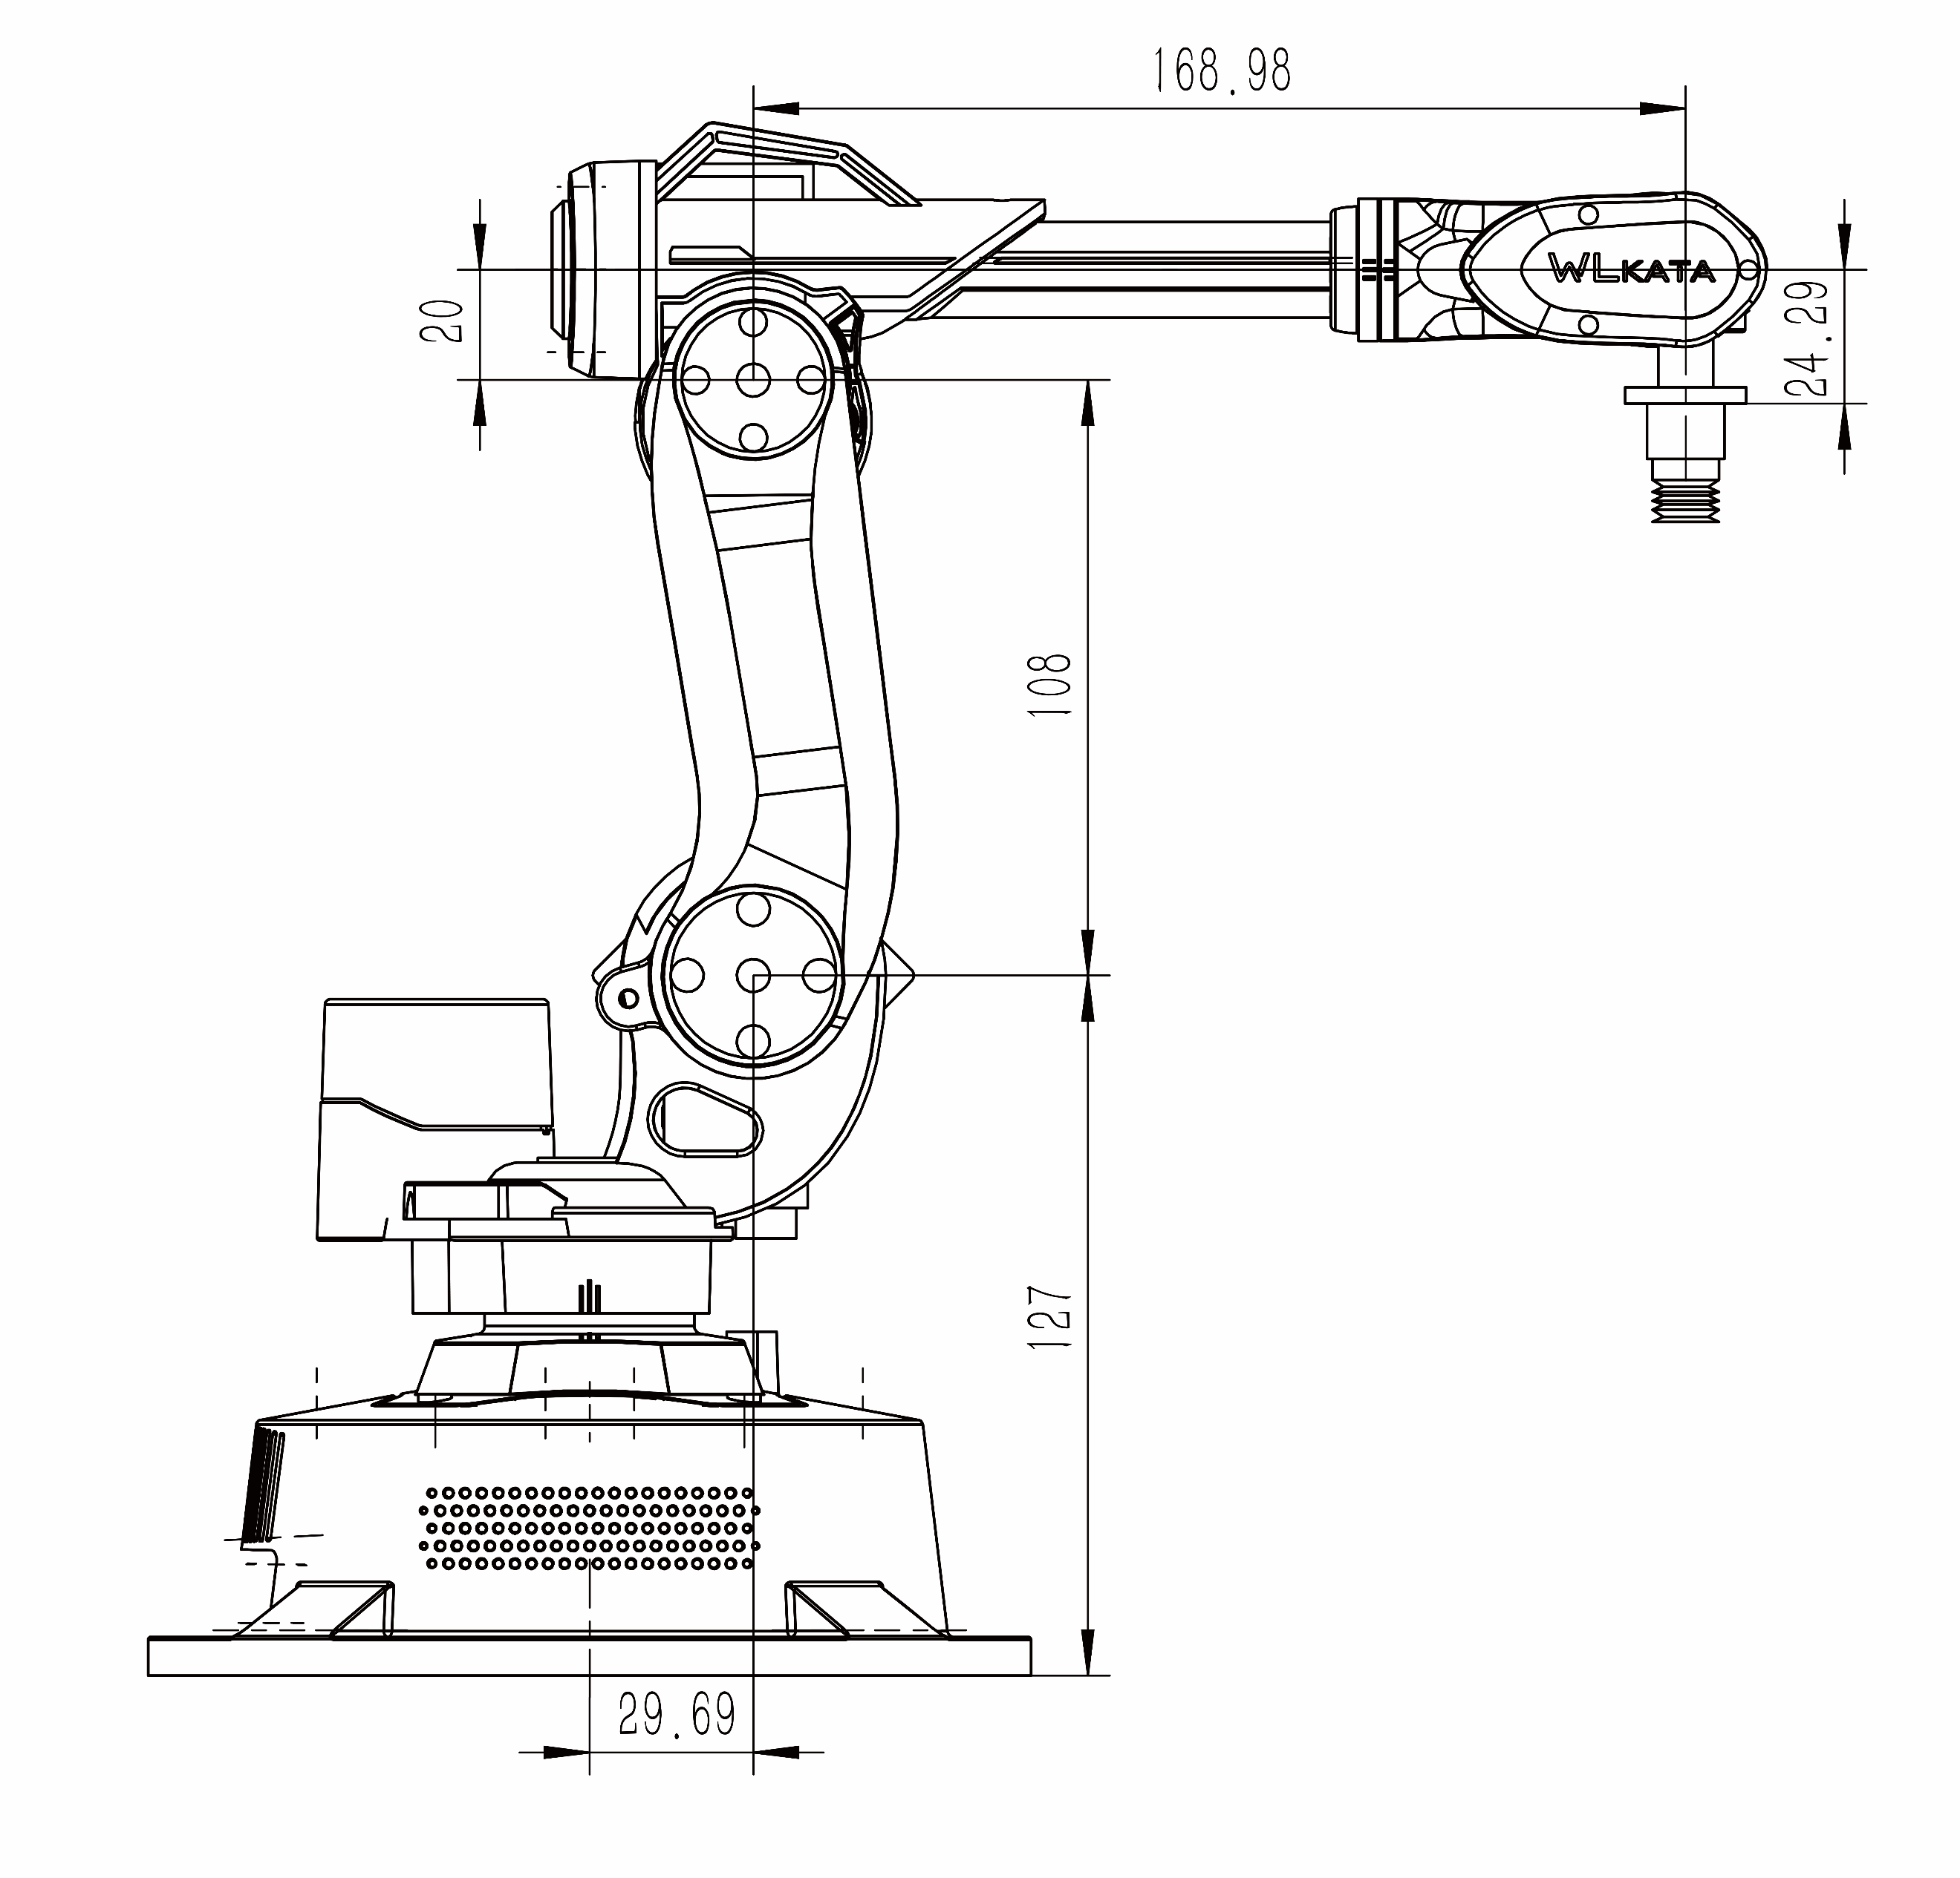
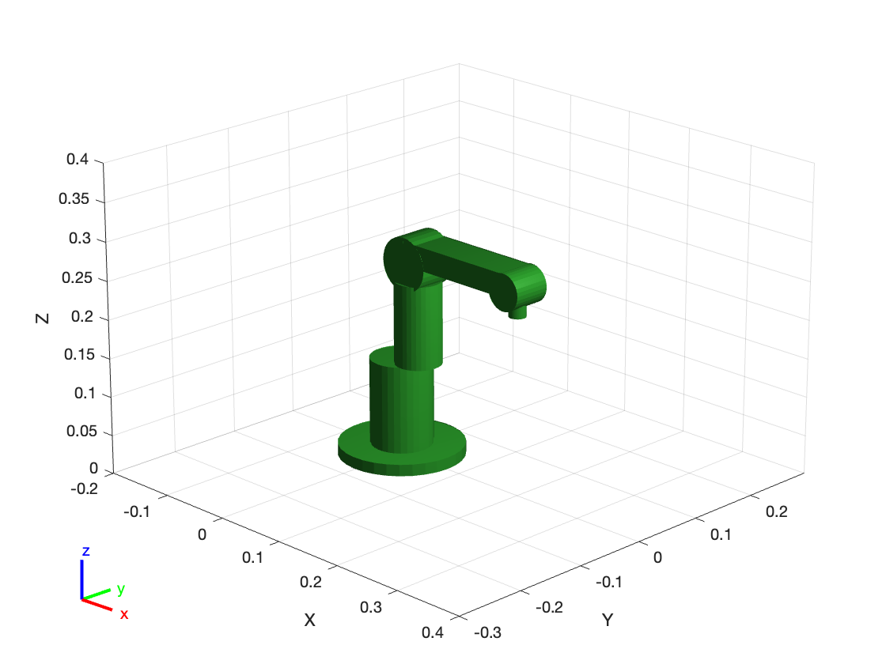
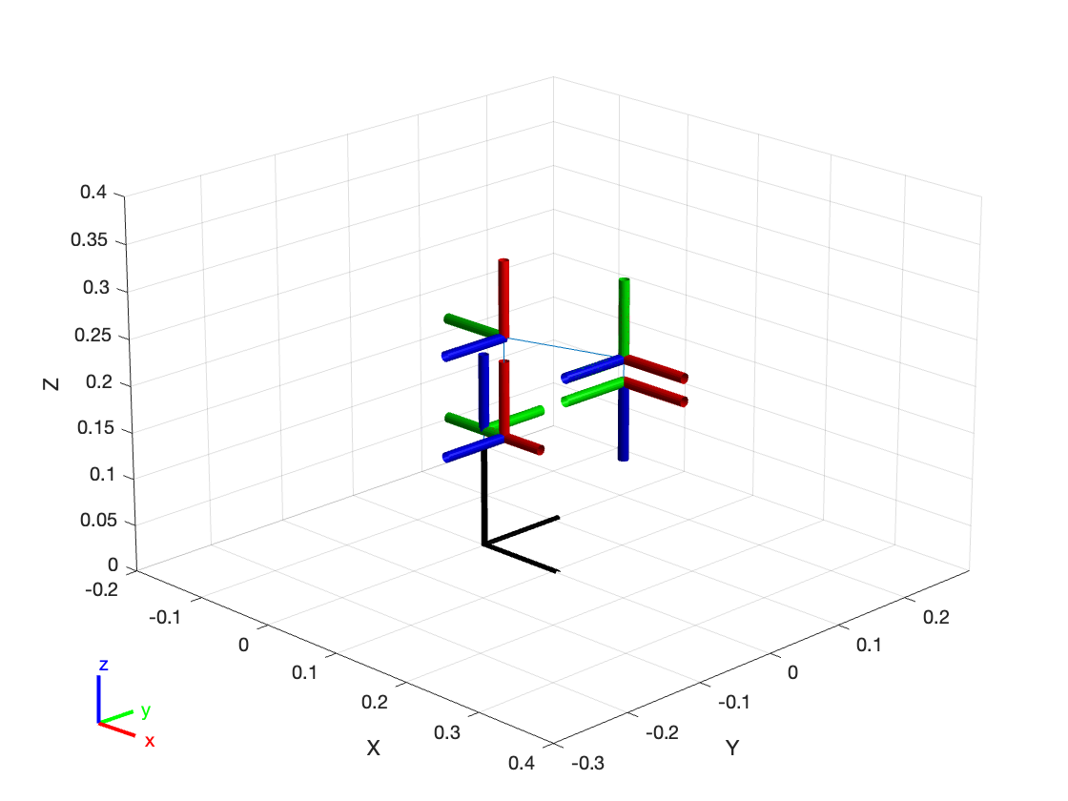
Task 1
Task 1 :MDH Table 1
MDH for CoppeliaSim
frame i | a（i-1） | alpha（i-1） | d（i） | theta（i）
1 | 0 | 0 | 127 | 0+θ1
2 | 29.69 | 90 | 0 | 90+θ2
3 | 108 | 0 | 0 | 0+θ3
4 | 20 | 90 | 168.98 | 0+θ4
5 | 0 | -90 | 0 | -90+θ5
6 | 0 | 90 | 24.29 | 0+θ6
J4 J5
J3
Defined frames
J6
J1
J2
base
Origin of frames

Slide 4
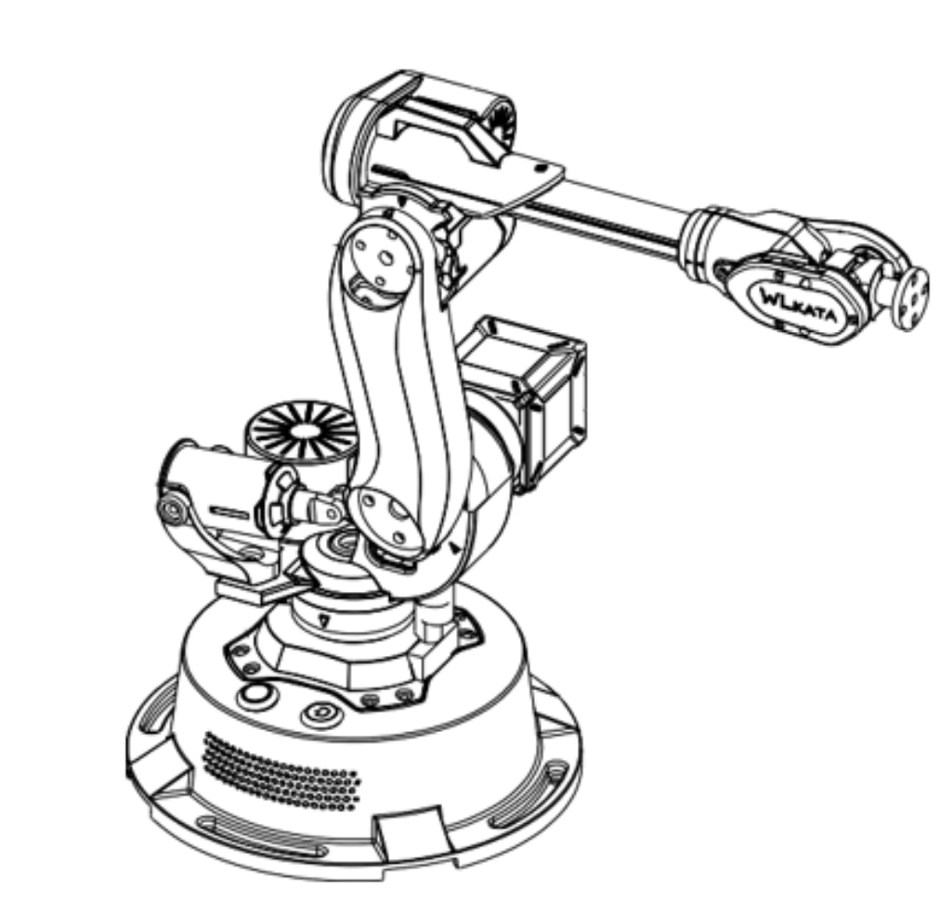
Task 1
Task 1 :MDH Table 2
X4
Y4
Z4
X3
MDH for Real Robot
Z4
Z3
Z5
frame i | a（i-1） | alpha（i-1） | d（i） | theta（i）
1 | 0 | 0 | 127 | 0+θ1
2 | 29.69 | -90 | 0 | -90+θ2
3 | 108 | 0 | 0 | 0+θ3
4 | 20 | -90 | 168.98 | 0+θ4
5 | 0 | +90 | 0 | +90+θ5
6 | 0 | -90 | 24.29 | 0+θ6
Y3
X2
X5
Z1
Y1
Y5
Z2
X1
Y2
X6
Y6
Z0
Z6
Y0
X0

Slide 5
Task 2
Joint Space Control

Slide 6
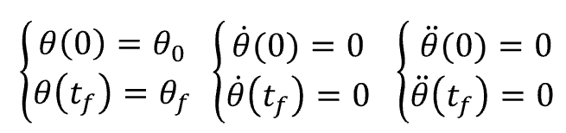
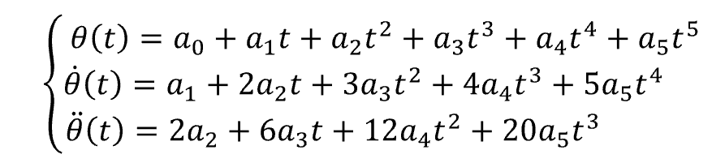
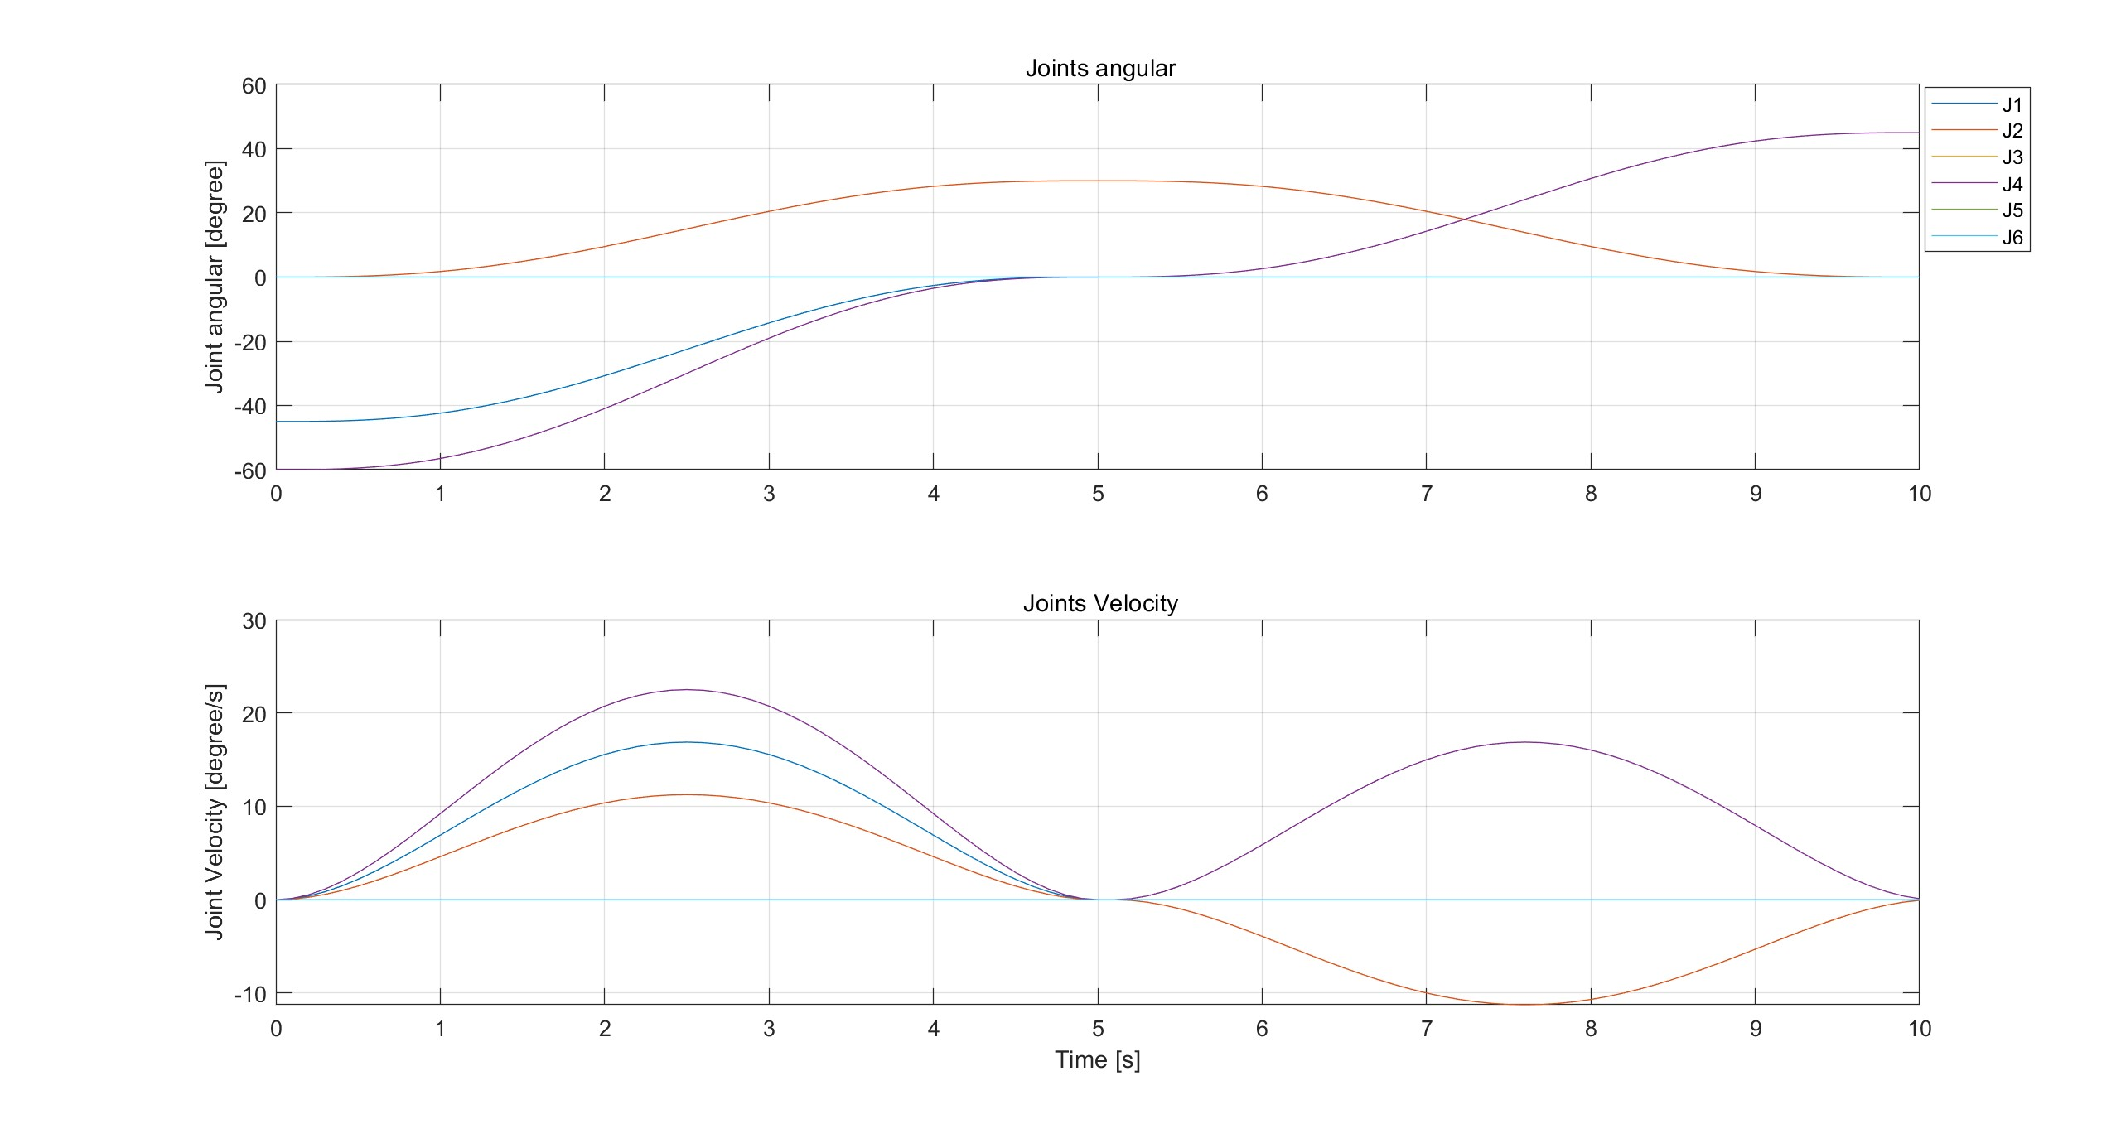
Task 2: Model
Path Planning
Quintic Polynomial
Forward Kinematics
Initial Pose
Intermediate Pose
Final Pose
Path 1
End-Effector Position
In Cartesian Space
Path 2
Result
Guarantee Joint Limits
 | Angular limit (deg) |  | Velocity limit (deg/s)
J1 | -110 | 160 | 85
J2 | -35 | 70 | 60
J3 | -120 | 60 | 65
J4 | -180 | 180 | 200
J5 | -200 | 30 | 200
J6 | -360 | 360 | 450
Notes:
finished

Slide 7
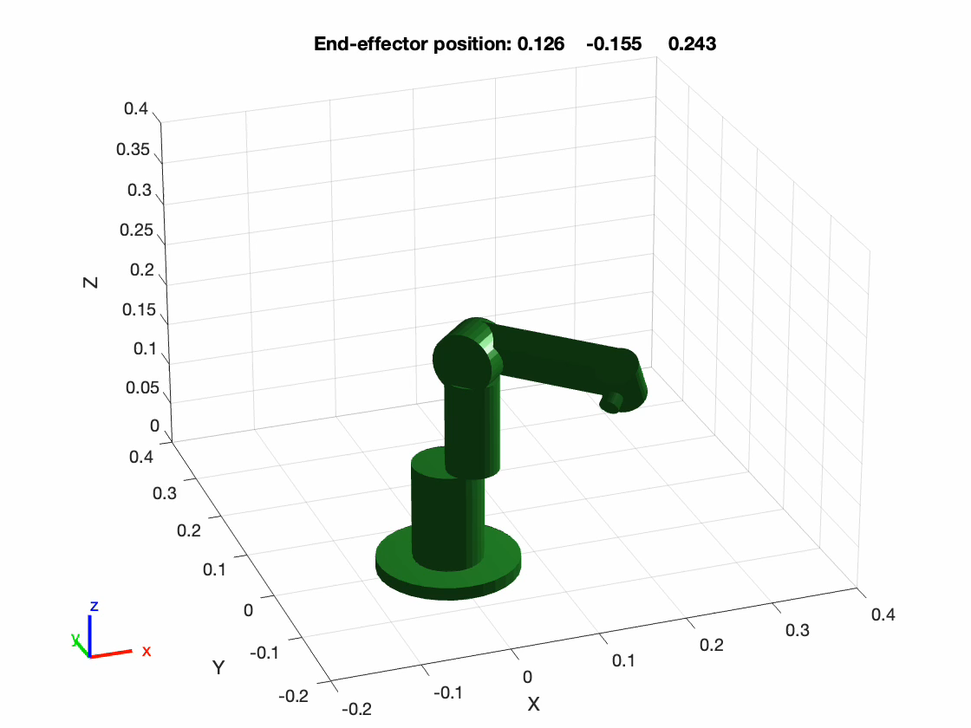
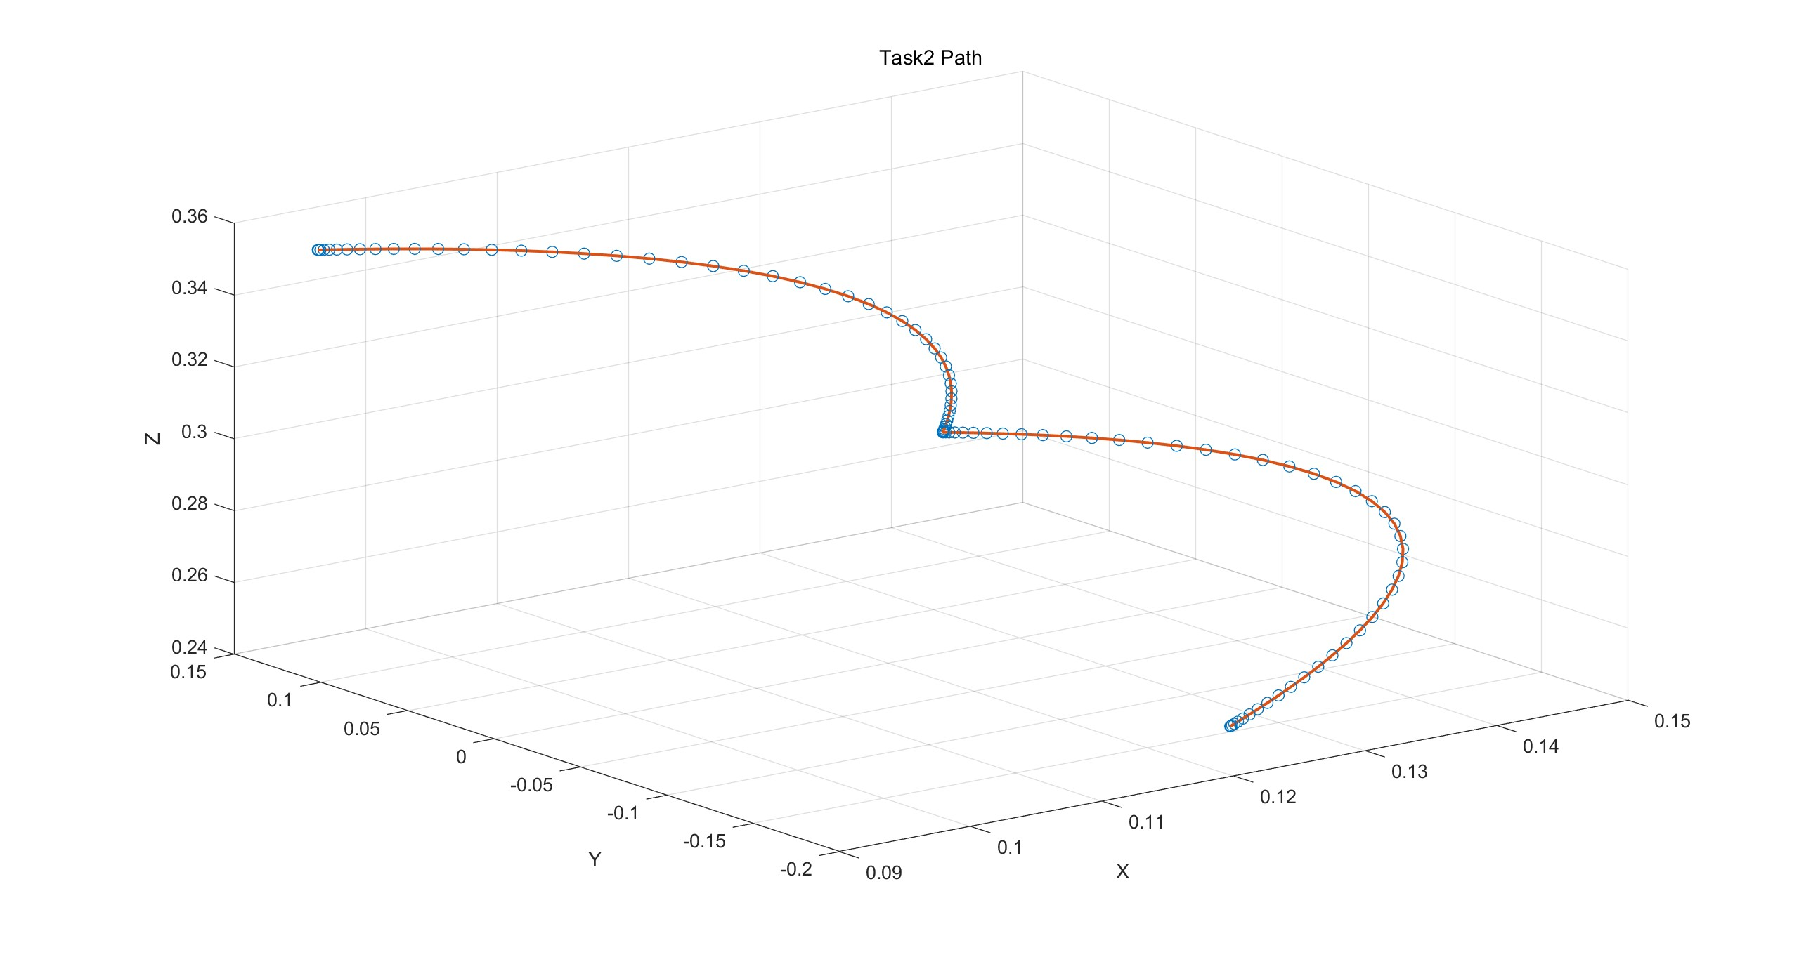
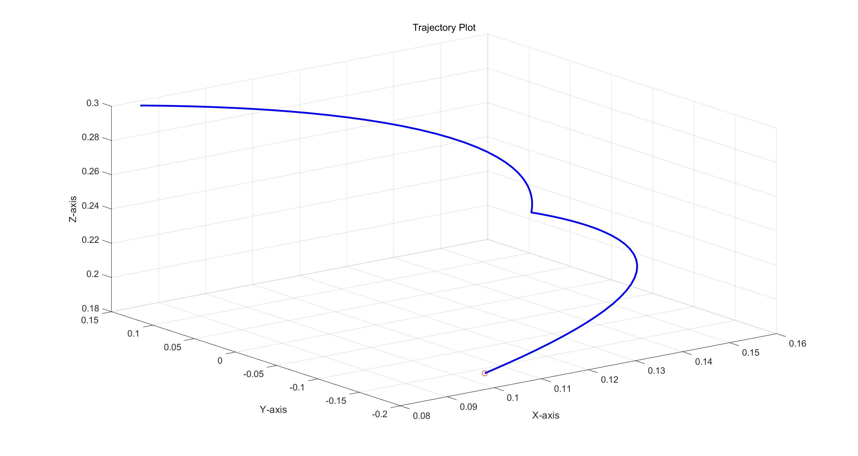
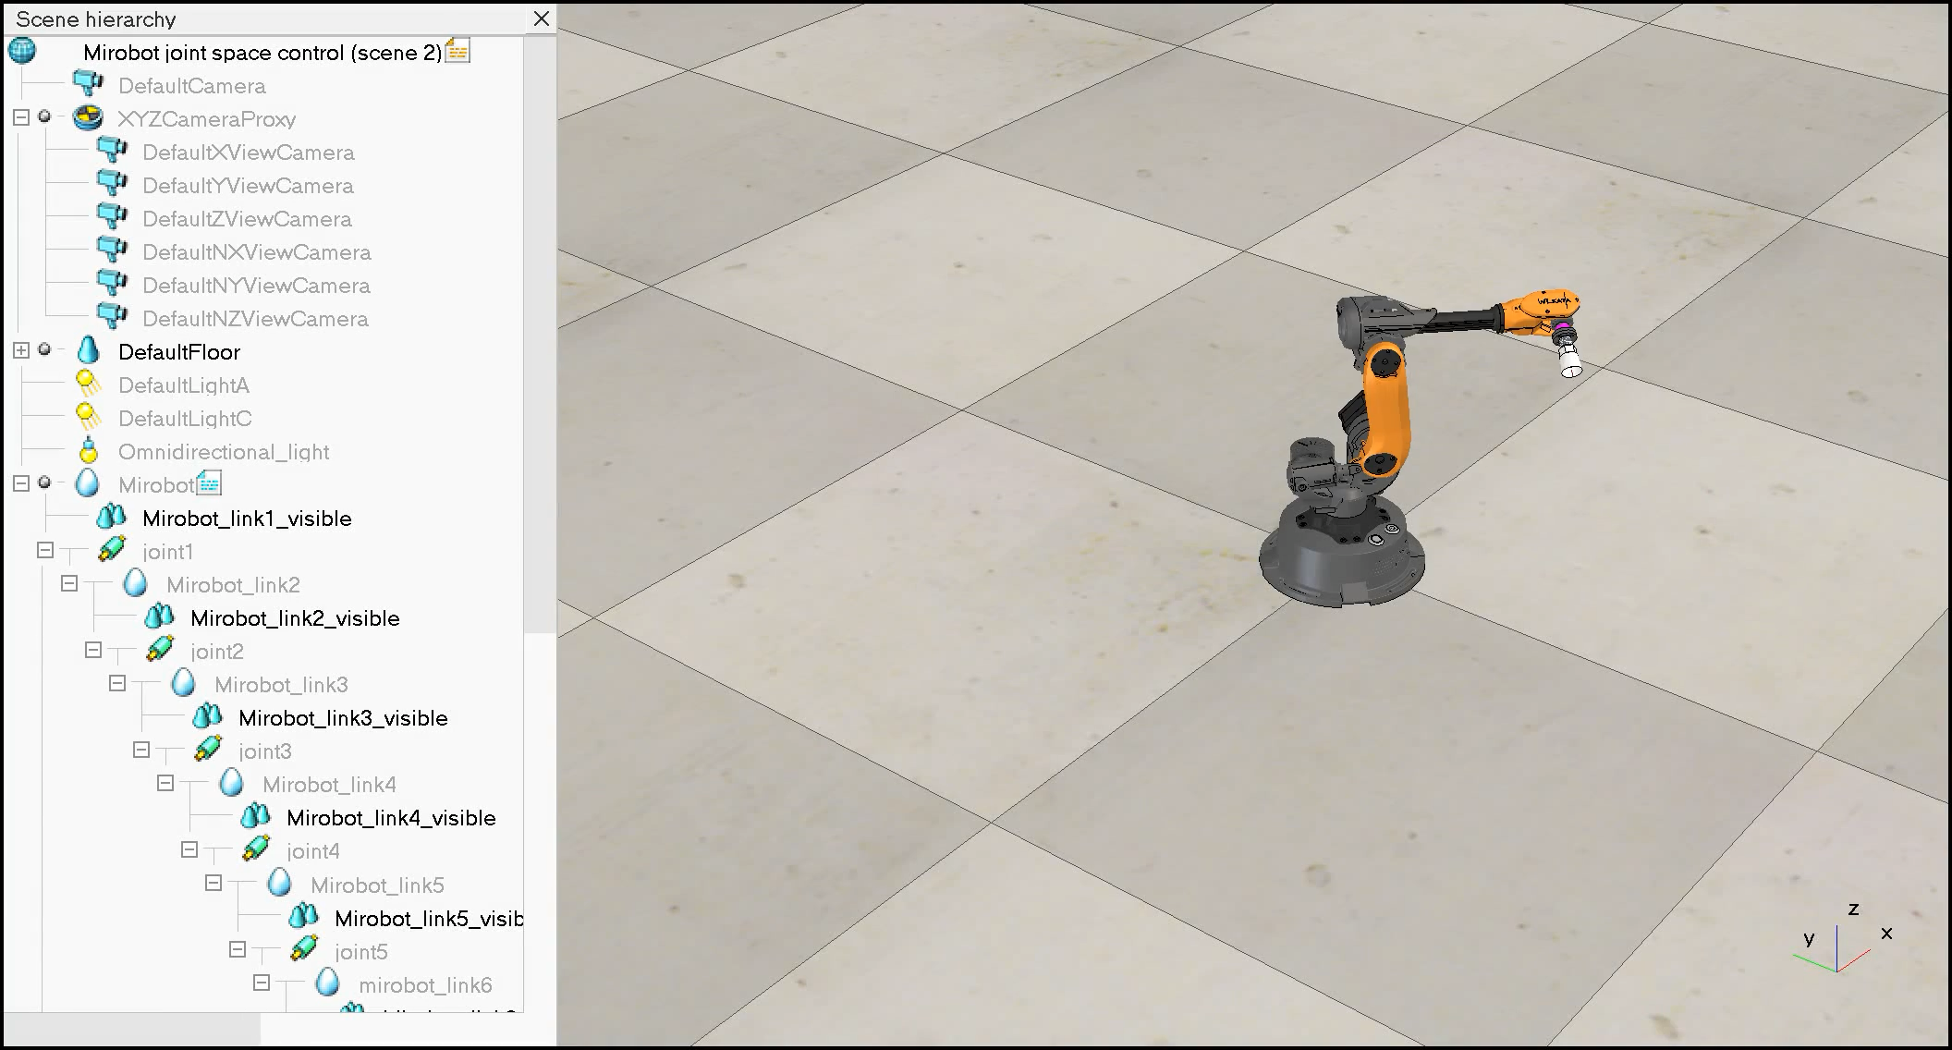
Task 2: Validation
Trajectory Validation
In Matlab
In Coppelia

Slide 8
Task 3
Cartesian Space Control

Slide 9
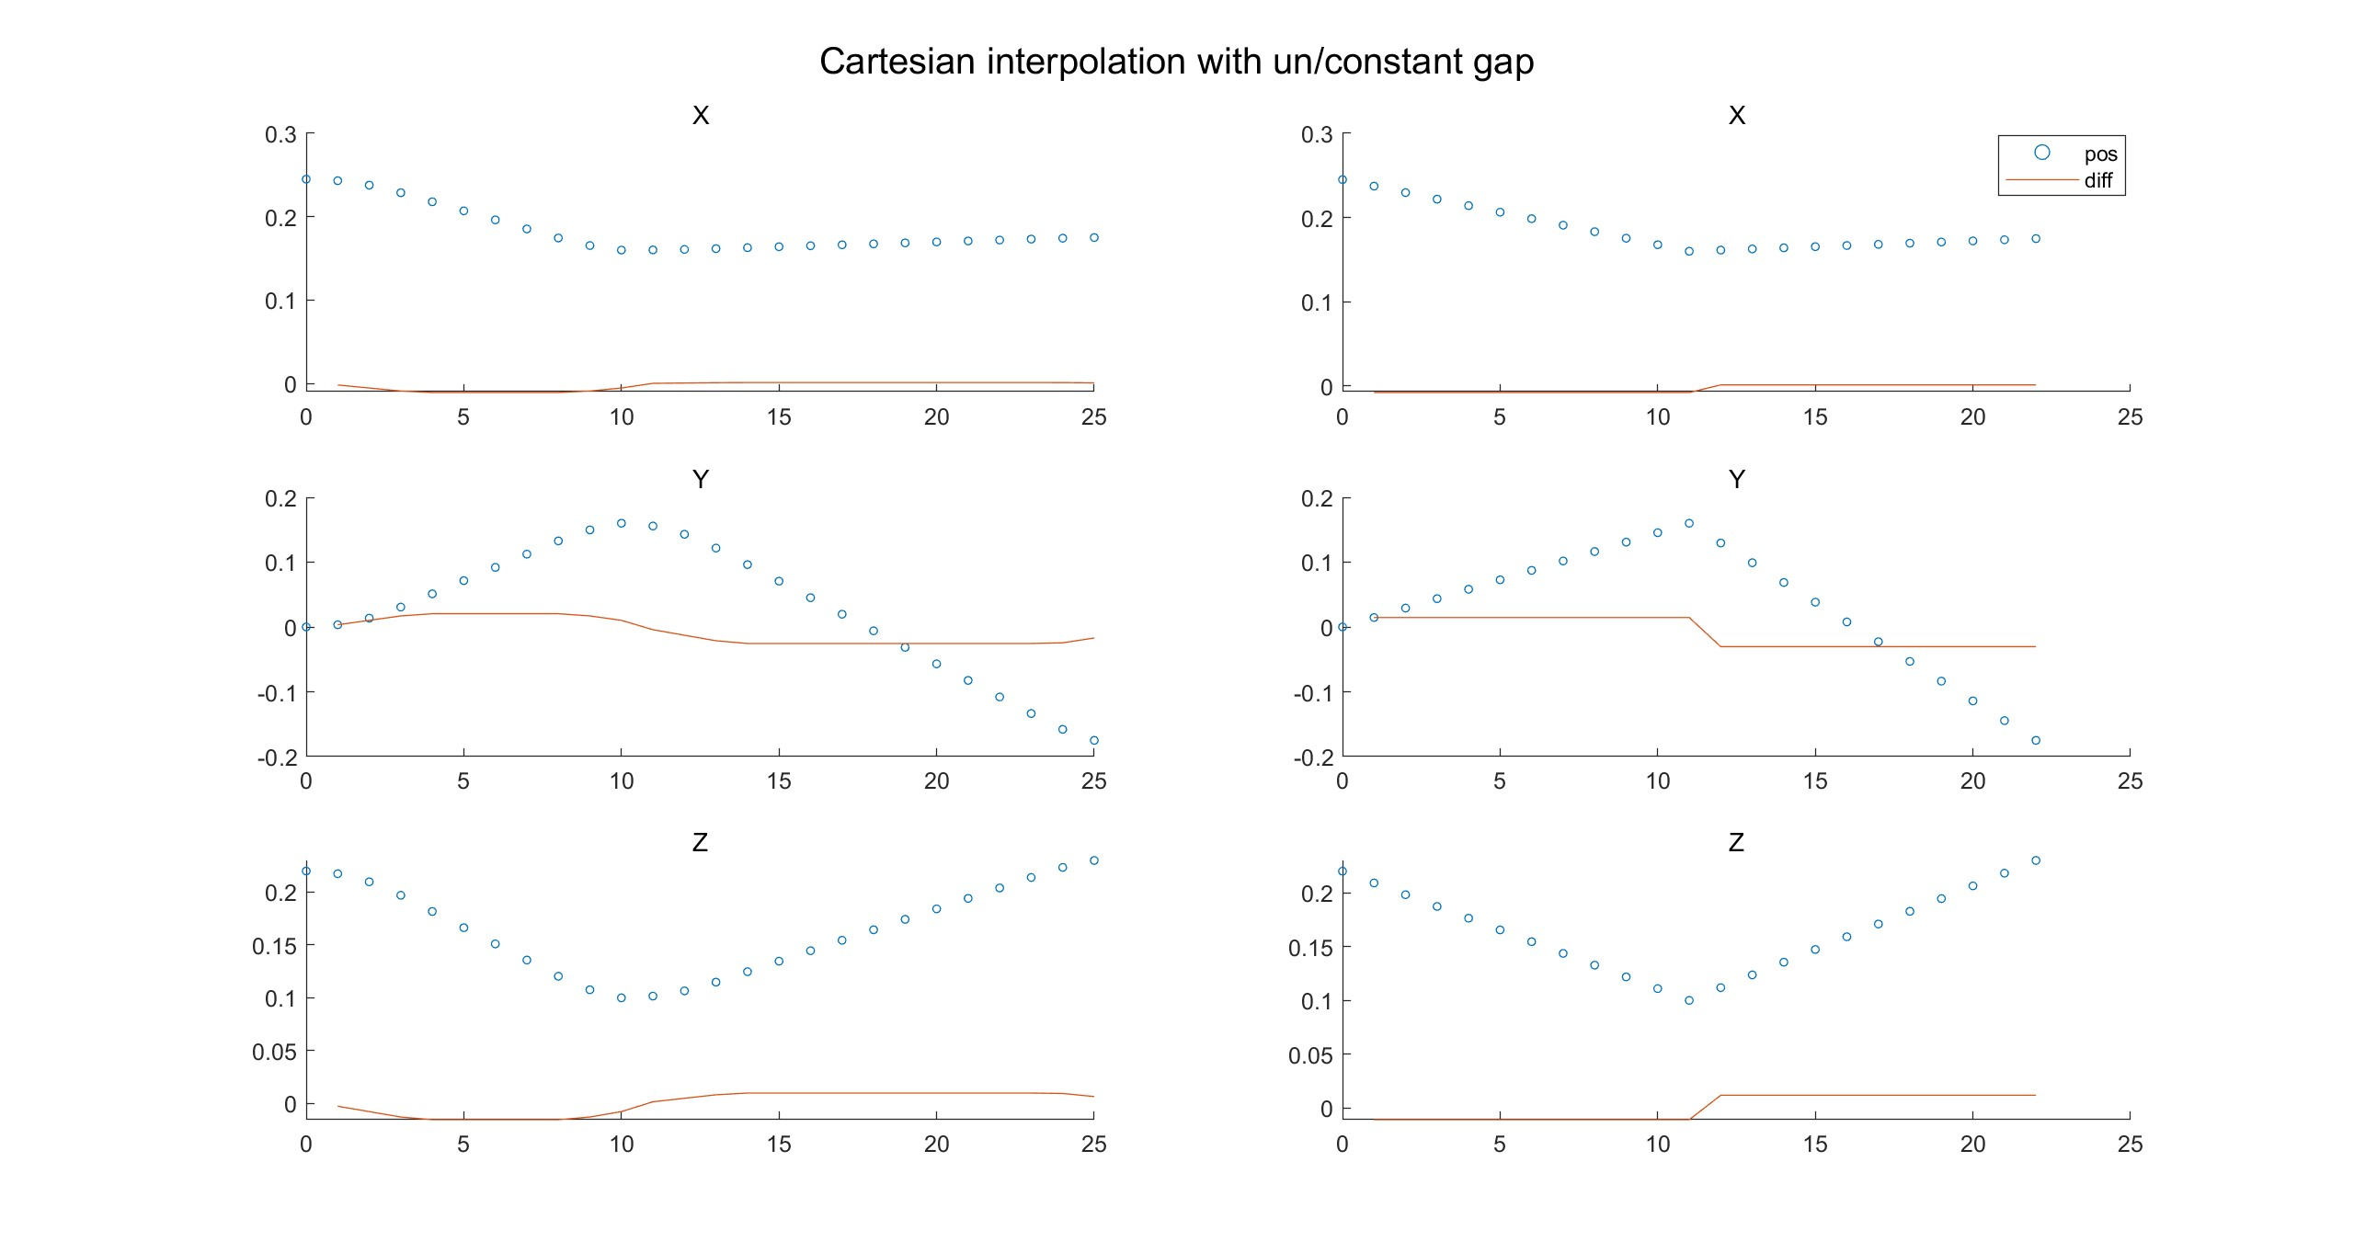
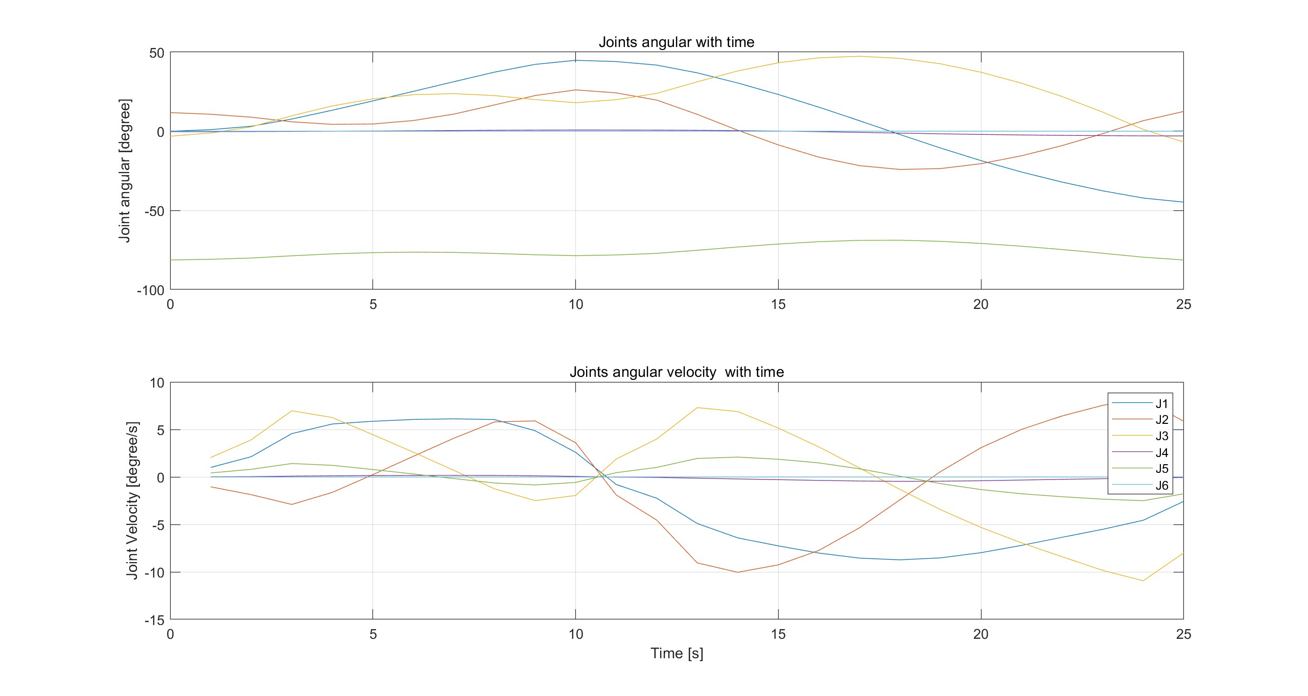
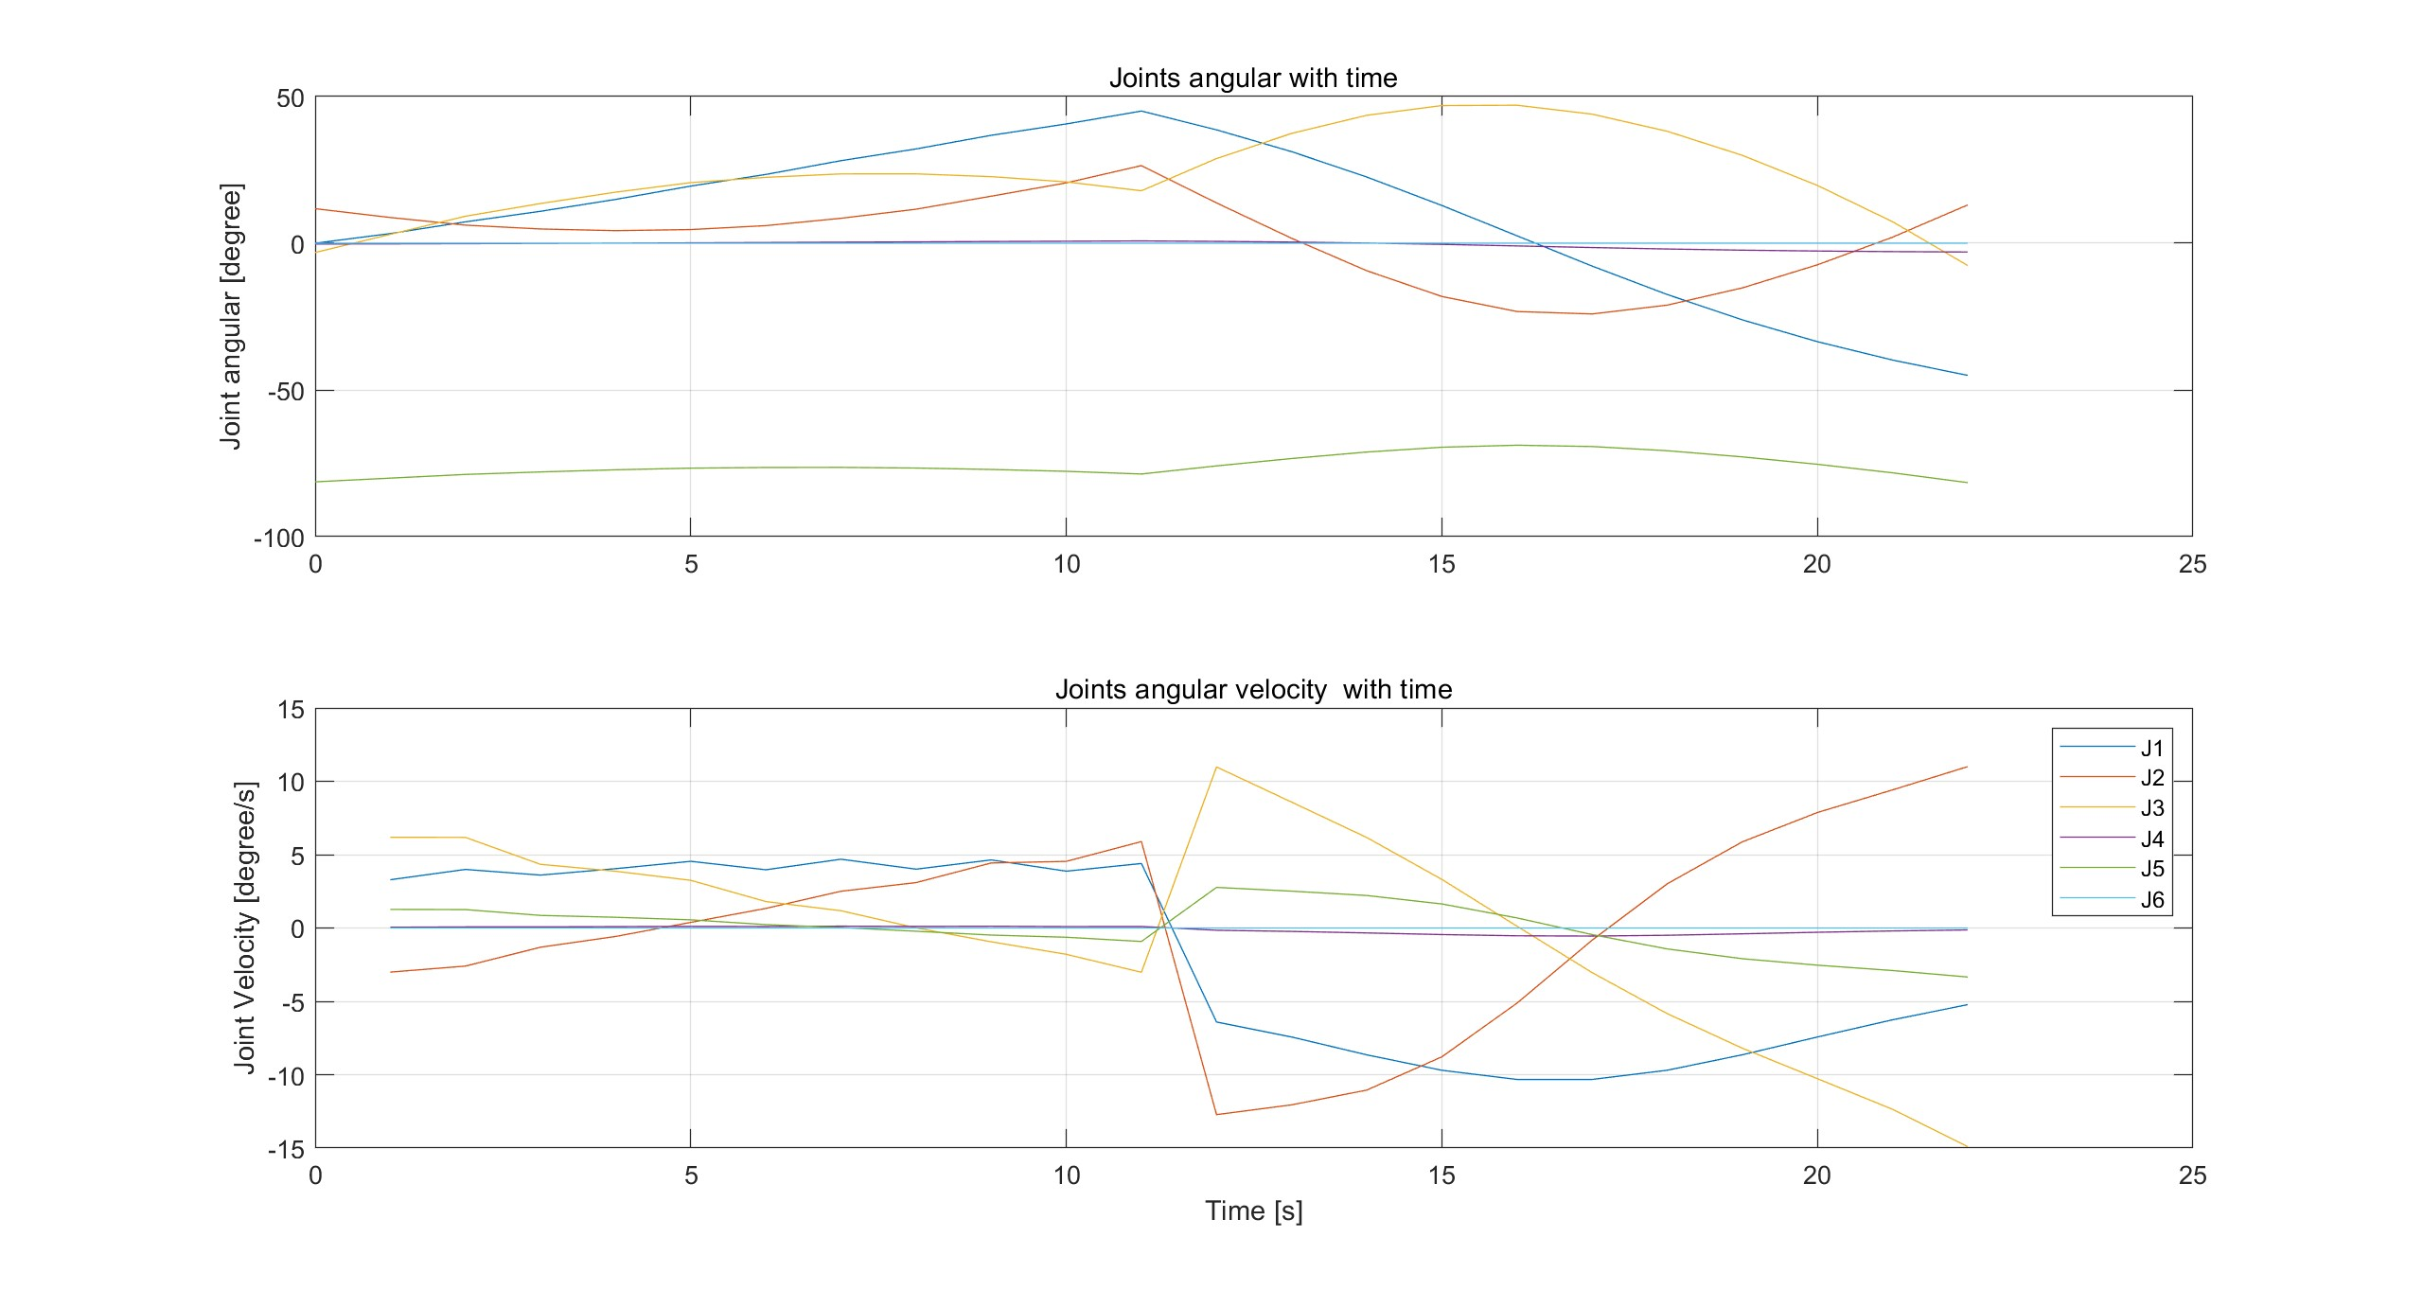
Task 3
Path Planning
InitialPose
IntermediatePose
FinalPose
Straight line
Inverse Kinematics
Joint Movement
Path Planning in
Cartesian Space
Joints Pose
Trajectory
Interpolation
Jacobian, Joint limits
Newton Iteration
Newton Iteration don’t converge?
(1) Check for Joint limit;
(2) Set learning rate=0.5, avoid oscillation
Interpolate with different gap
Interpolate with same gap

Slide 10
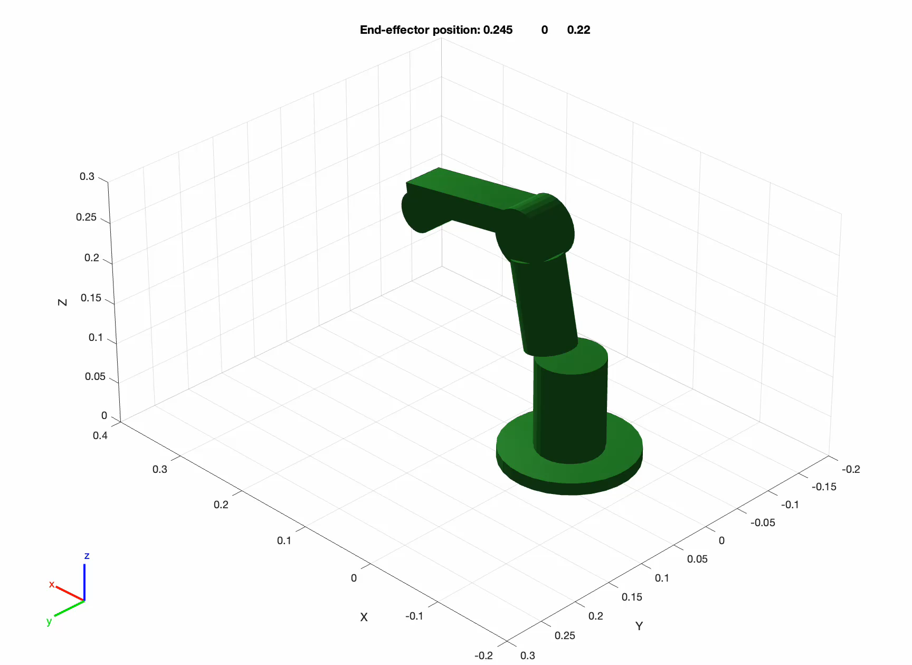
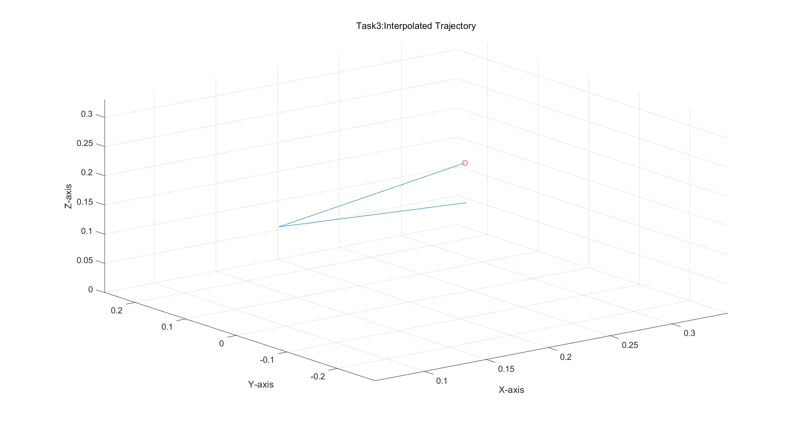
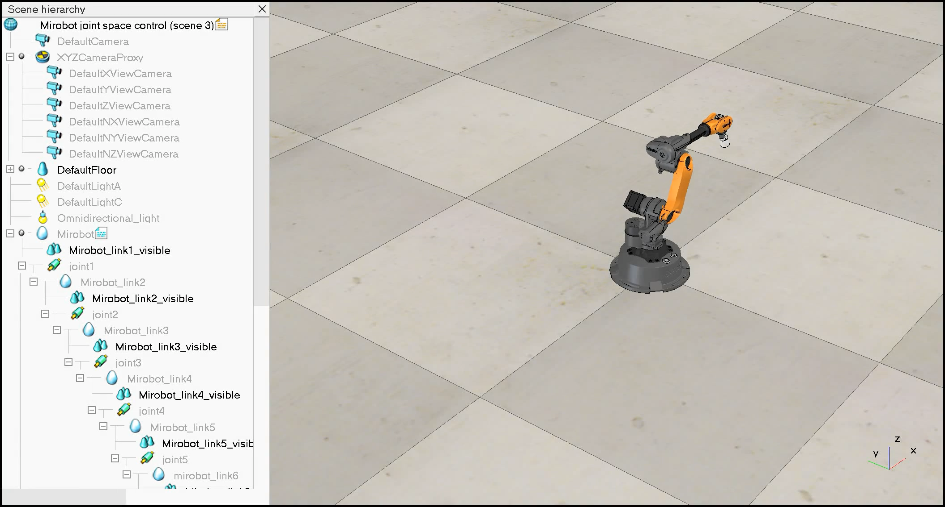
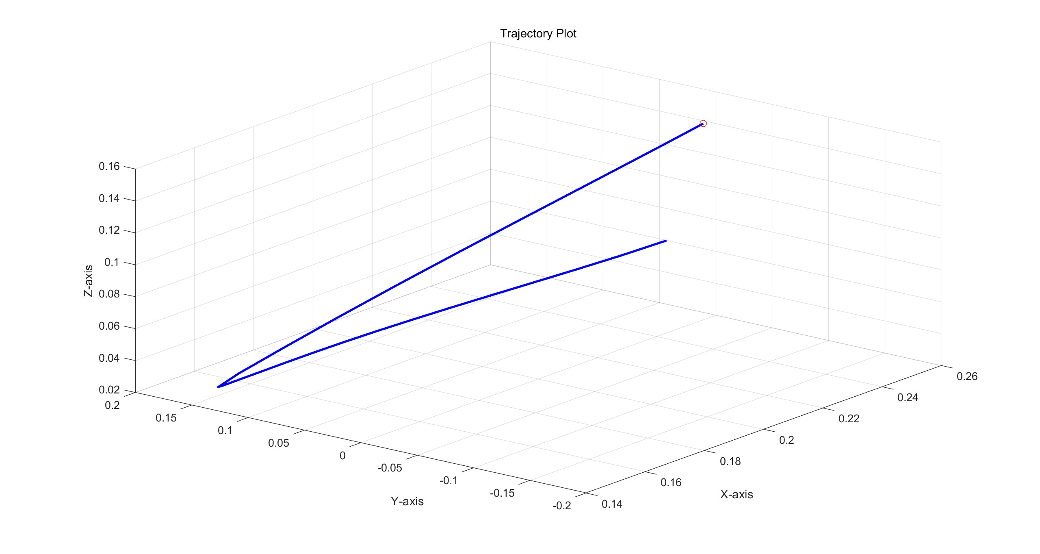
Task 3 : Validation
Trajectory Validation
In Matlab
In CoppeliaSim
Notes:
视频和仿真的视频

Slide 11
Difference between Cartesian and Joint space control
Task3 : Comparison of two methods
Cartesian space control
Joint space control
Trajectory defined in end effector position
Easy to visualise trajectory
Joint motion derived from end effector path through inverse kinematics
Joint speeds and acceleration can be non-uniform
Instability near singularities or areas where large changes in joint spaces are required
Robot independent
Preferred when control of end effector position is key
e.g. robotic surgery, drawing etc
Trajectory defined in terms of joint angles/positions
Not easy to visualize trajectory
Joint motion controlled hence uniform motion
The performance is less prone to vibration
No problem with singularities
Robot dependent
Preferred method when space is limited or when carrying out tasks where control over joints is key e.g. obstacle avoidance

Slide 12
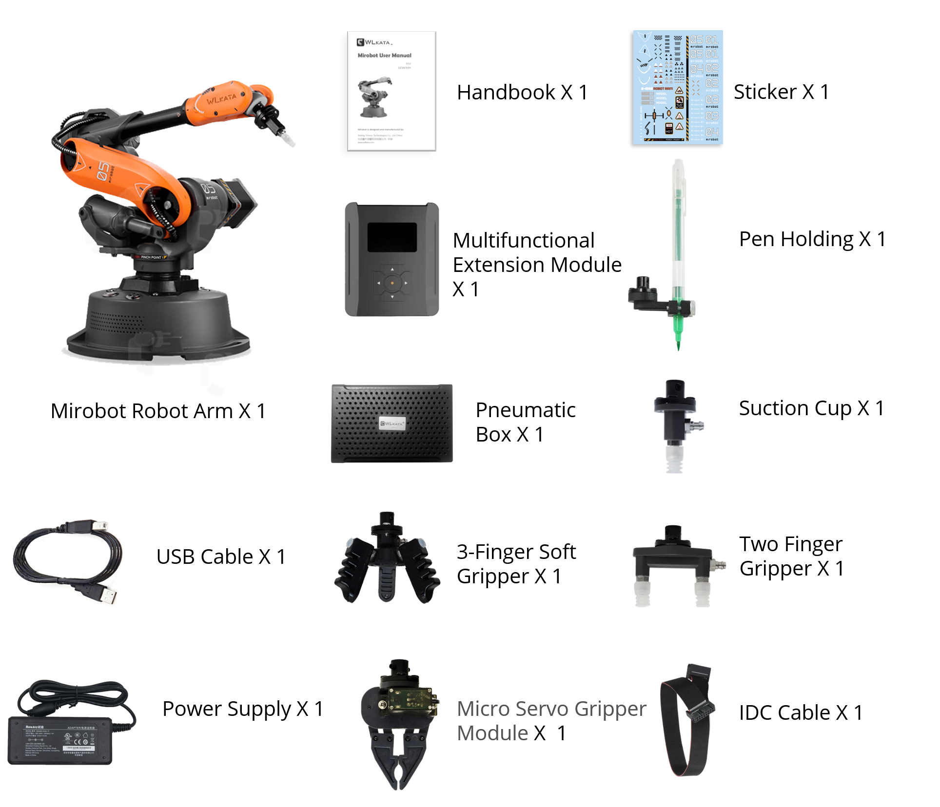
Task 4: Robot Pick-and-Place
Three-Finger Soft Gripper
[1]

Slide 13
Task 4
Joint-Space Method
Trajectory planning using waypoints
Polynomial Interpolation
Jacobian & IK
Waypoints Initiating
Path planning in Joint-Space
Joint-Space
Joint Pose
Two main challenges:
Mount E-E
Keep Gripper Straight downwards

Slide 14
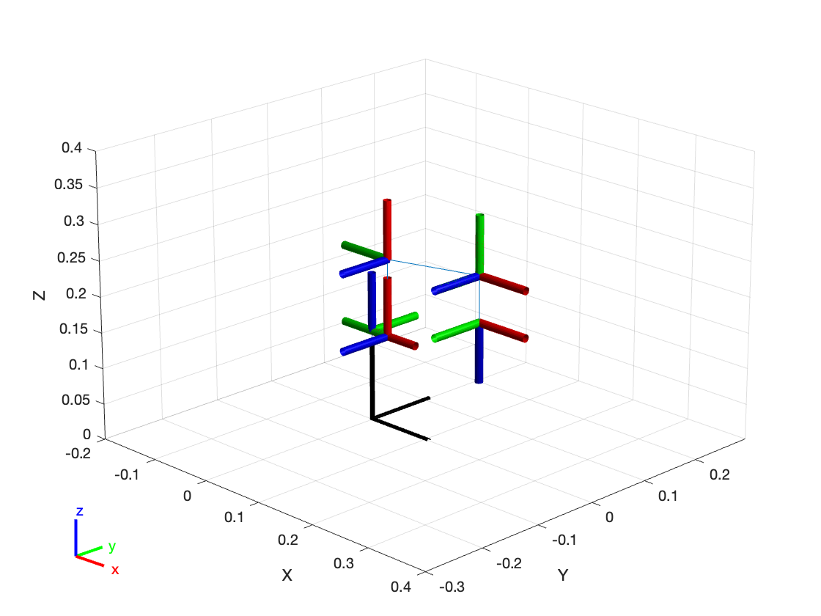
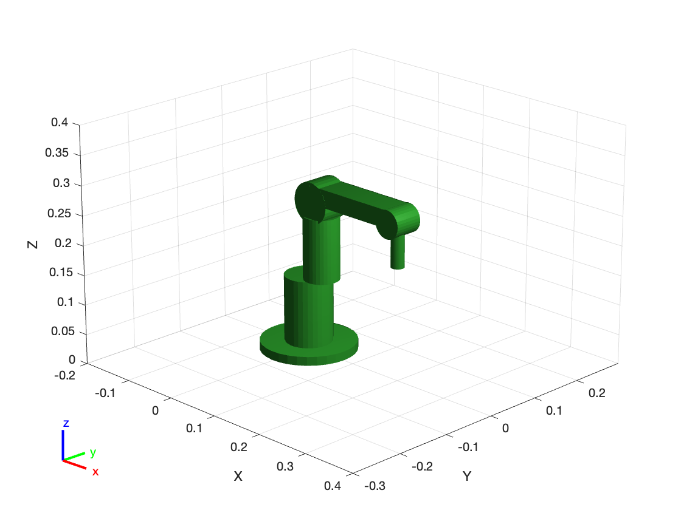
Task 4
Challenge 1: Mounting E-E
New DH table to extend link 6 length
New robot model with end-effector
frame (i) | a （i-1） | alpha（i-1） | d （i） | theta（i）
1 | 0 | 0 | 127 | 0+θ1
2 | 29.69 | -90 | 0 | -90+θ2
3 | 108 | 0 | 0 | 0+θ3
4 | 20 | -90 | 168.98 | 0+θ4
5 | 0 | +90 | 0 | +90+θ5
6 | 0 | -90 | 24.29+40 | 0+θ6

Slide 15
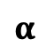



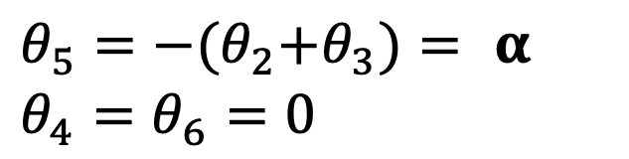
Task 4
Challenge 2: Gripper downwards
J3
$$α$$
J5
$$θ_{3}$$
During Jacobian and IK
$θ_{5}=$ ${−{(θ}_{2}+θ}_{3})= α$
$$θ_{4}=θ_{6}=0$$
$$θ_{2}$$
$$θ_{5}$$
J2
Reach the destination:
No θ constraints at Point 5

Slide 16
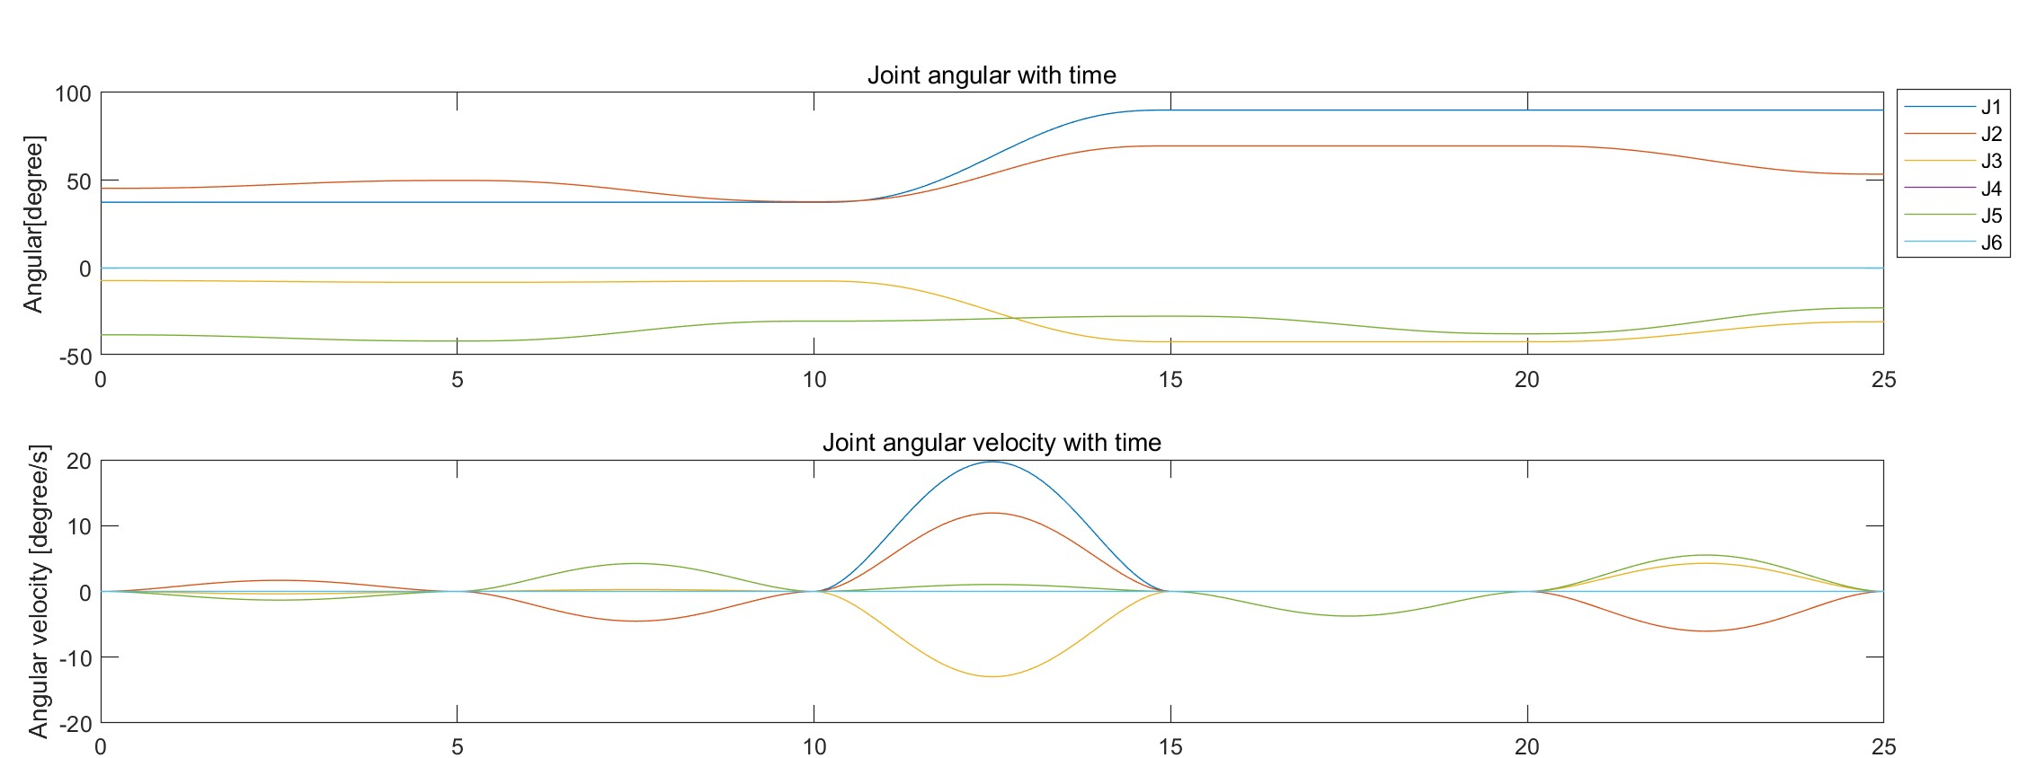
Simulation Result
Angular Velocity

Slide 17
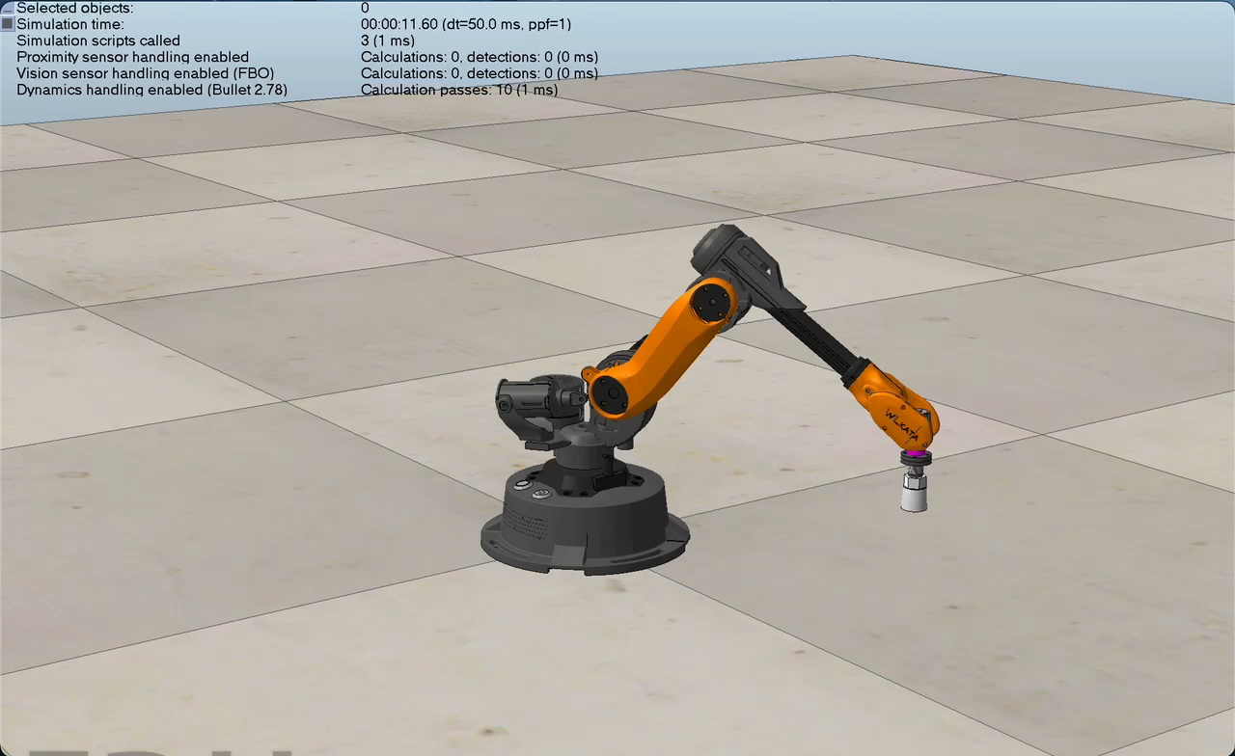
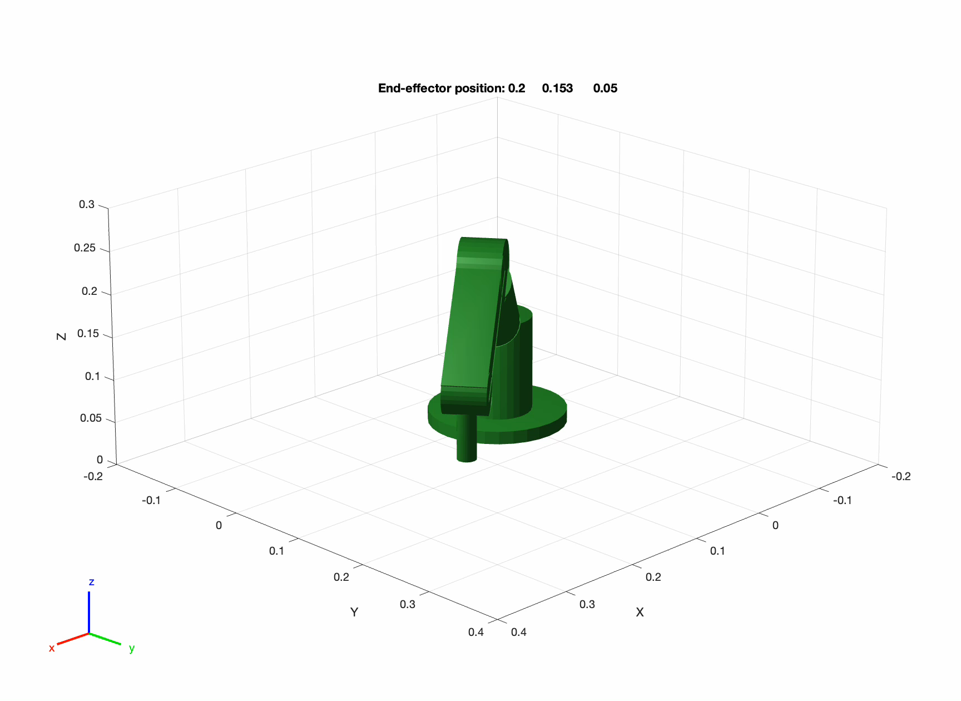
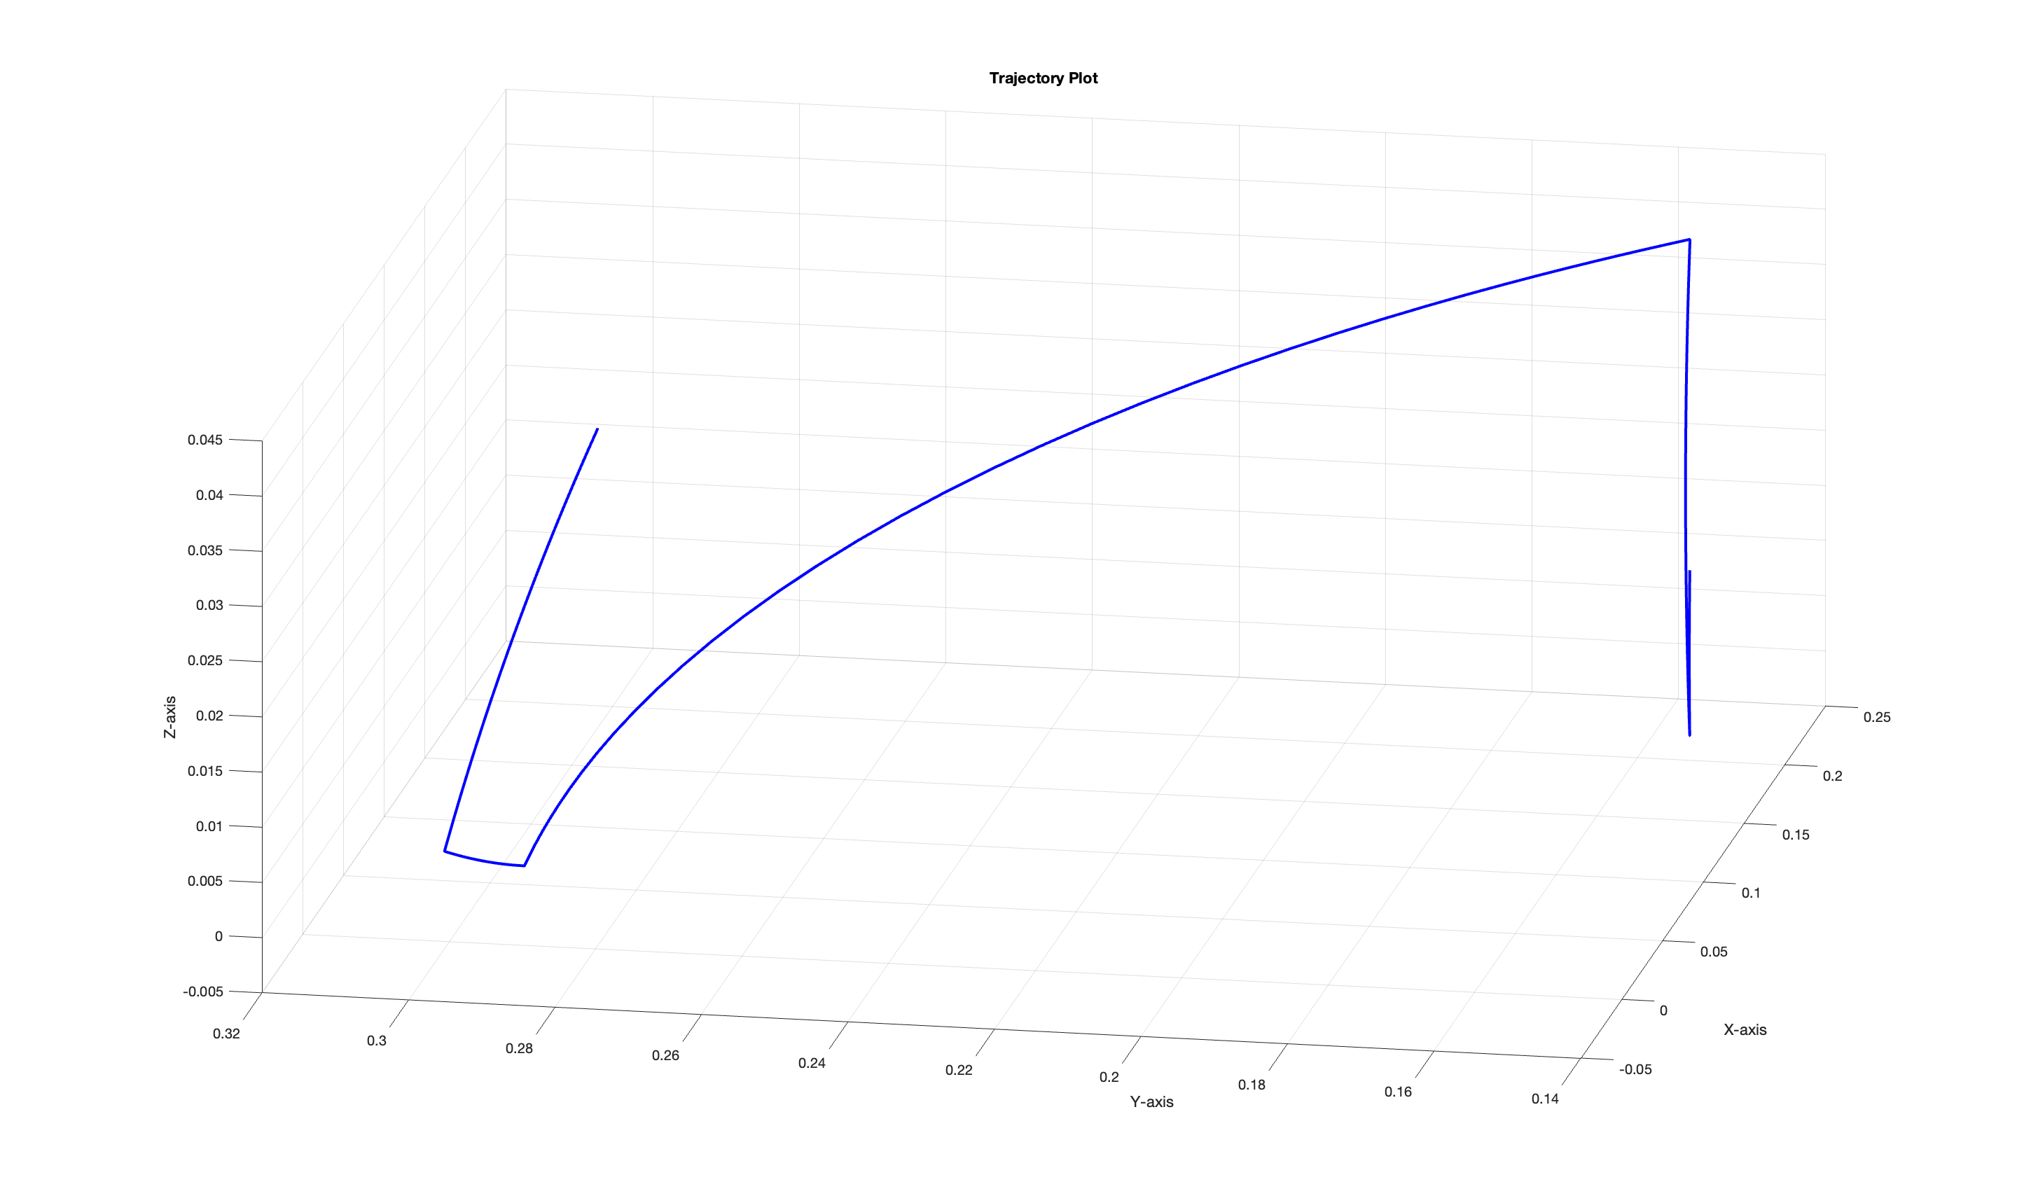

Slide 18
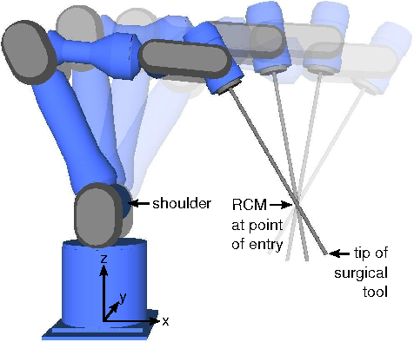
Bonus Task
Minimally Invasive Surgery
A Robot arm with RCM point illustration [2]

Slide 19
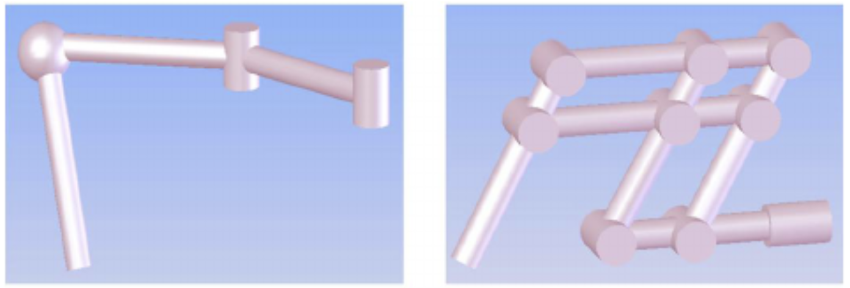
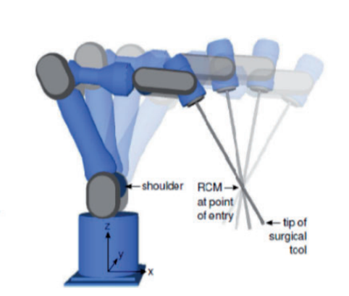

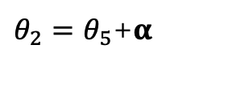

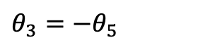

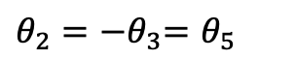




Geometry Solution
Passive Joint
Double parallelogram[3]
RCM
RCM
J3
J3
J5
$$α$$
J5
$$θ_{3}$$
$$θ_{3}$$
$$θ_{5}$$
$$θ_{2}$$
$$θ_{5}$$
$$θ_{2}$$
J2
J2
RCM
RCM
$θ_{2}=$ ${−θ}_{3}=θ_{5}$
$θ_{3}=$ ${−θ}_{5}$
$θ_{2}=θ_{5}$+$α$

Slide 20
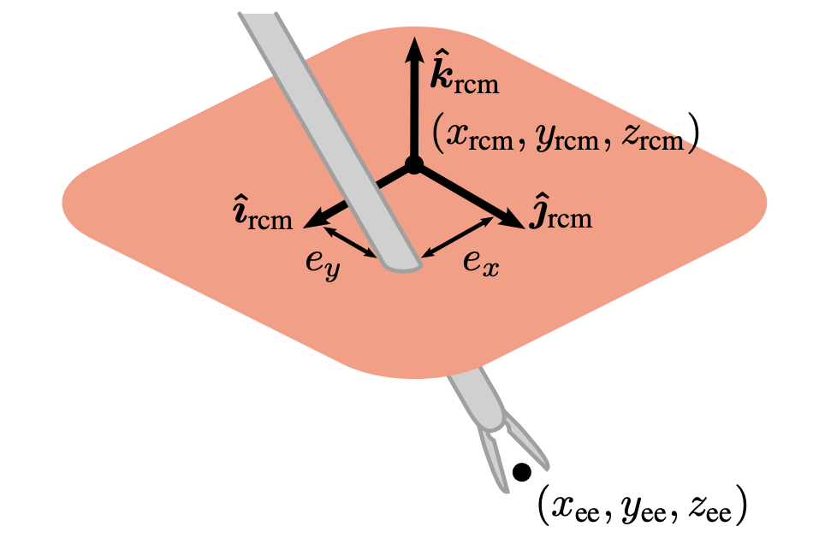
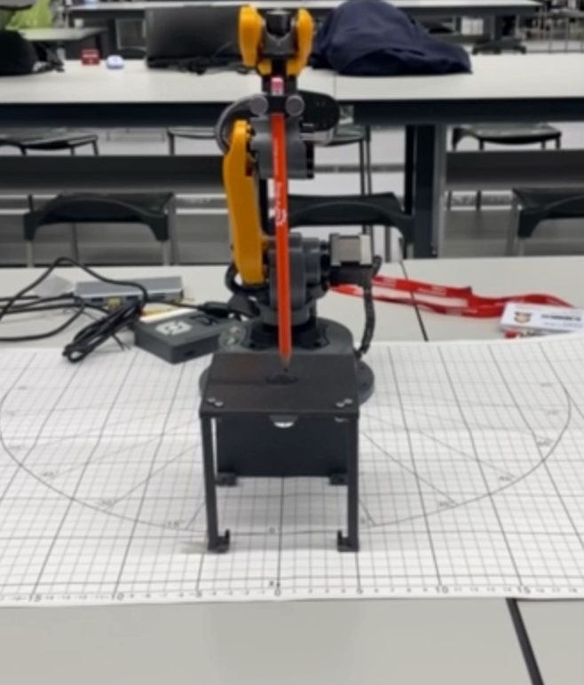
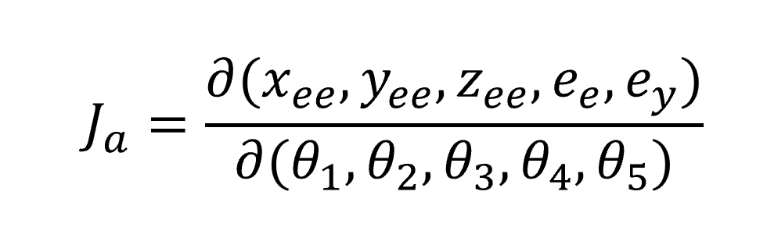
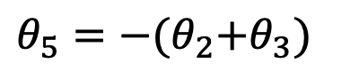
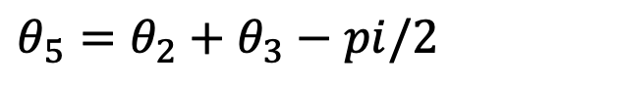
Combined with Algebra Solution
[2]
Only 3 Variables
Keep End-Effector Horizontal Direction
$θ_{5}=$ ${θ_{2}+θ}_{3}−pi/2$
Vertical Direction
$θ_{5}=$ ${−{(θ}_{2}+θ}_{3})$

Slide 21
Reference
[1] WLKATA Robotics, “WLKATA Robotics Documents” Available at https://document.wlkata.com/?doc=/
[2] Locke, R.C., & Patel, R.V. (2007). Optimal Remote Center-of-Motion Location for Robotics-Assisted Minimally-Invasive Surgery. Proceedings 2007 IEEE International Conference on Robotics and Automation, 1900-1905.
[3] Kim, Sung-Kyun & Shin, Won-Ho & Ko, Seong Young & Kim, Jonathan & Kwon, Dong-Soo. (2008). Design of a compact 5-DOF surgical robot of a spherical mechanism: CURES. IEEE/ASME International Conference on Advanced Intelligent Mechatronics, AIM. 990 - 995. 10.1109/AIM.2008.4601796.

Slide 22
Q & A
Thanks for listening!

